Slide 1

Notes:
I believe that we live in a matrix!

Slide 2

Circuit Design
Prof.Dr. -Ing Andreas Siggelkow
Anand Kishore Babu Shiji & Gautham Gireesh

Slide 3
Outline
The Problem
Solution Proposal
Solution Implementation
Technical Specification
Other Applications

Slide 4


The Problem
Notes:
The corona pandemic -> the whole world is suffering from it
So there is a necessity to keeping distance ->

Slide 5


Corona Restrictions
Life during corona
Social distancing
The necessity to limit the number of people in a room.
Notes:
So we need to restrict th number of people per place or per room
If a person do a job

Slide 6
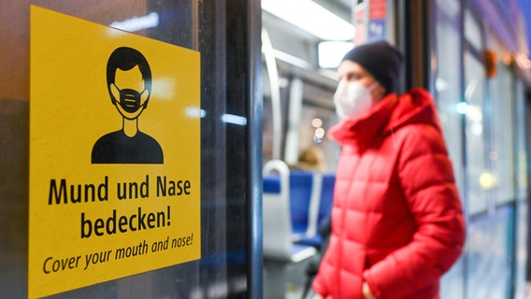
Our solution
Notes:
We have a solution for this problem . an FPGA device which counts the flow of peope( in /out) then when max peope reached stops the flow
OVERALL DESCRIPTION OF THE PROJECT

Slide 7
Characteristics and key features
Max 1000 board build with intel Max 10 FPGA
Light curtain sensors to find the direction of person
Maximum capacity can be changed
Information and values transferred to computer via RS232 interface
A clear button to reset the count
LED's to control the flow of people
Assumption
Only one door for entrance and exit
Only one person at a time

Slide 8
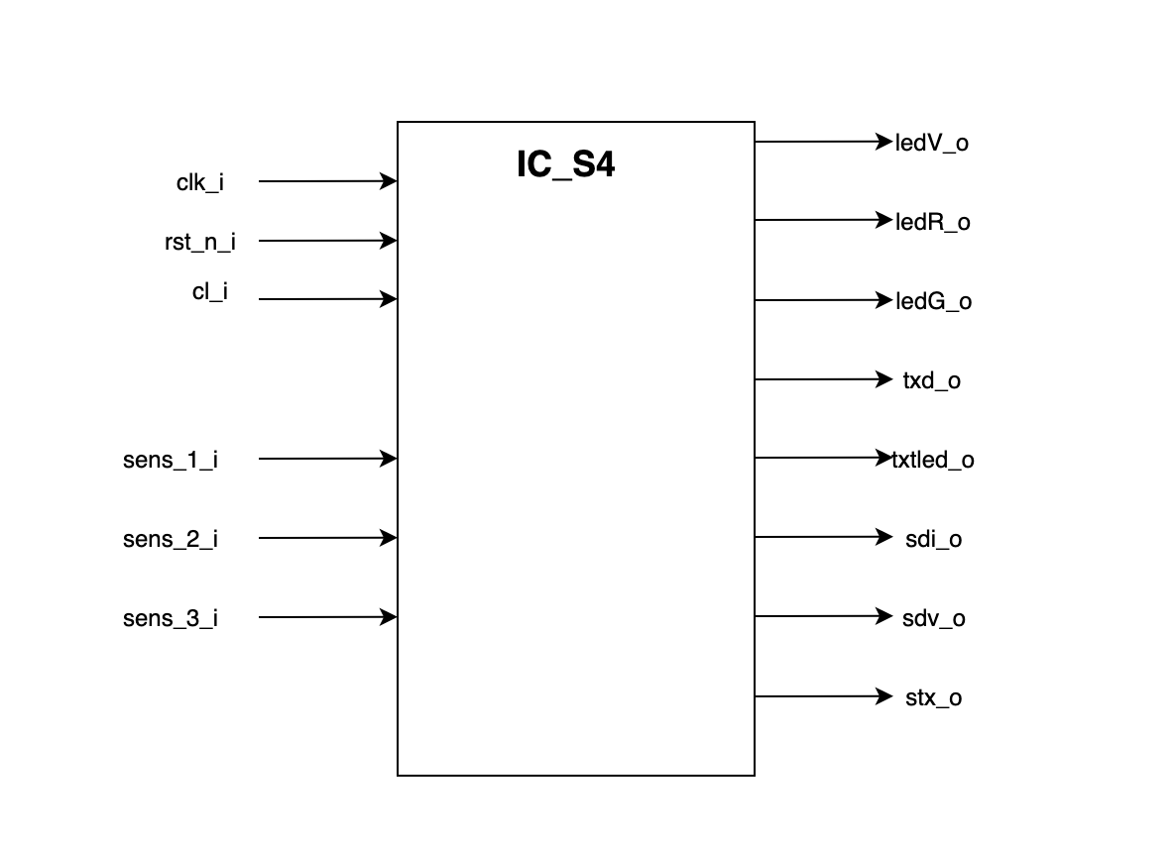
Top level View

Slide 9
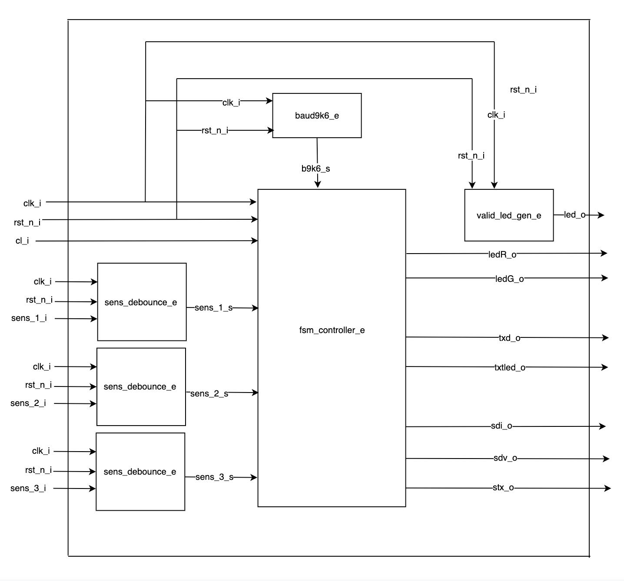
Top level Block Diagram

Slide 10
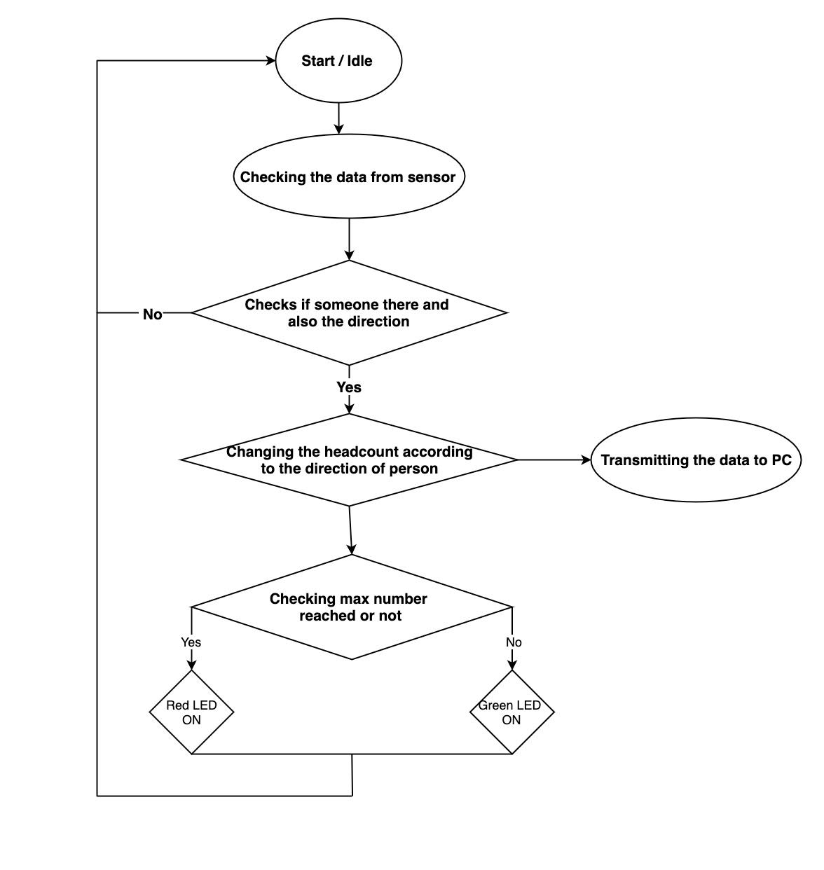
Flow Chart

Slide 11
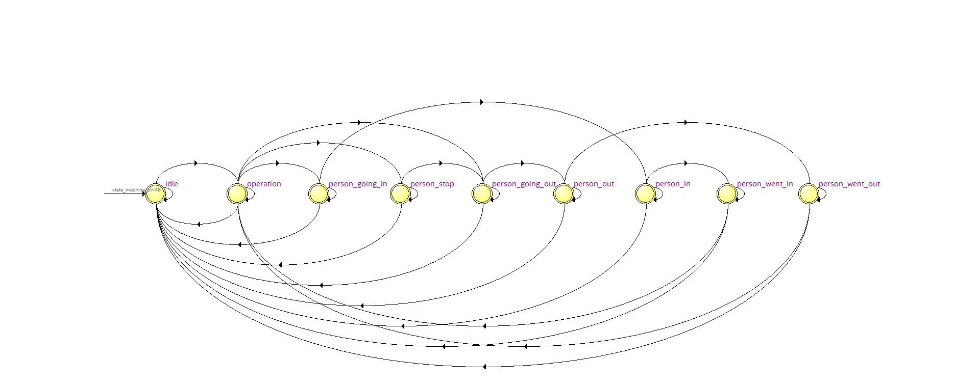
States of the FSM

Slide 12
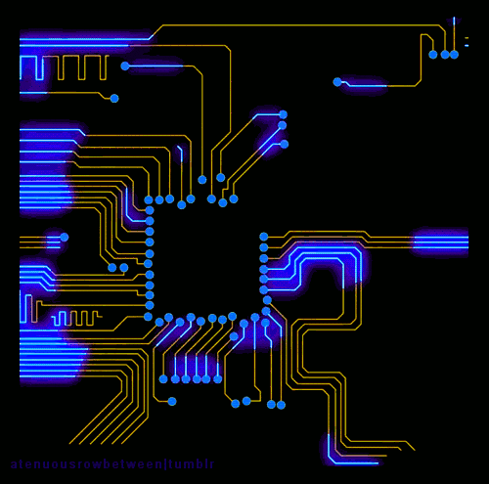
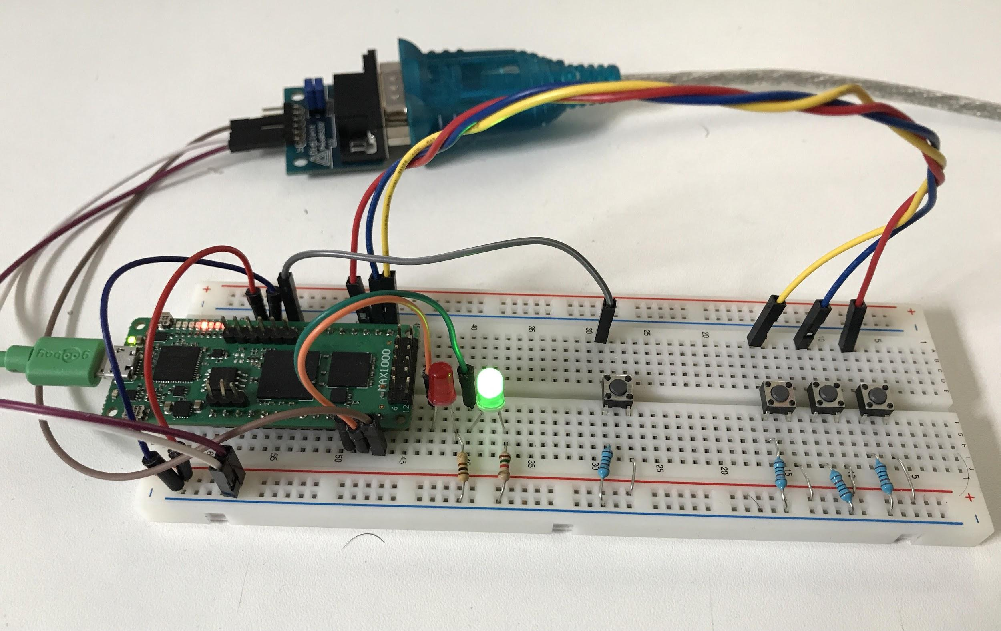
Breadboard setup

Slide 13
Applications
Real life applications of this project
This idea can be implemented in lot of ways in real life
Places where there is a limited seating capacity
In public transports
On conveyor belts to count objects
THIS DEVICE HAS A LARGE SCOPE AND CAN BE MODIFIED AND USED IN DIFFERENT AREAS

Slide 14

References
https://www.statista.com/chart/20964/covid-19-cases-europe-map/
Corona-Regeln in SH: Das ist erlaubt, das ist verboten | NDR.de - Nachrichten - Schleswig-Holstein
https://campus-stories.htw-berlin.de/jahr/2020/tipps-gegen-corona-angst/
https://www.shutterstock.com/search/fpga
We have uploaded all our files in to a github repository reference : https://github.com/AnandKishore21/vhdl_sem4

Slide 15
THANK YOU

